Slide 1
Project Report:CSE 362 DATA MINING
Deepak Gokharu | Rajat Khandelwal | Md Kamran Siddiqui | Gaurav Kumar

Slide 2



Improving Retailer Consumer connectivity Data Mining Techniques
OFFline ONline

Slide 3

Retailer in the Digital era
With the growth of e-commerce websites, retailers tend to fail to attract more and more consumers.
With an increase in globalization and competitiveness, retailers are seeking a better market campaign
Retail industry is looking at a strategy wherein they can target the right customers who may be profitable to them.

Slide 4




Solution through Data Mining
Prioritize
Analyze
Monetize
Study customer segmentation, customer behavior towards products
Time-series product analysis, product associativity, P&L on combinations
Employ targeted marketing techniques based on analysis by data mining
Our project deals with sales data and customer data that retailers can collect through online shopping websites. Now we will use that data to analyze and finding knowledge using Data mining concepts and methods

Slide 5

Slide 1
Data & Process flow preparation
Data Preprocessing
Applying Data Mining Algorithms
Data Visualization
Knowledge Discovery from Data
Solving Retailers’ dilemma
PREPROCESSING:
Checking null values
Removing outliers
Converting data into usable format to apply algorithms
Visualization:
Plotting sales data
Plotting customers demographics data with sales
When scaling, group all elements to be scaled. Scale as needed. Use the “Increase Font Size,” “Decrease Font Size” buttons or manually change the font size for the editable text. Delete unwanted elements. Change the line weight of the circles or connecting bars as needed.

Slide 6

3 Paths to KDD
Anlaysis of customer’s data will give us a detailed description about what & from where are the customers in proximity buying the products
P&L details on each & every item sold in a transaction, product performance in SALEs & discounts
Product support & min. confidence by using apriori algorithm to decide which combination is the deal breaker
Knowledge Discovery from Data

Slide 7
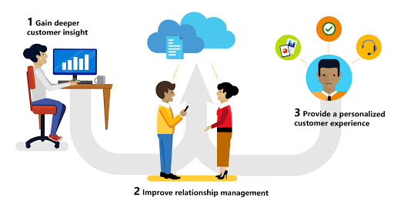
Project Goals
Ultimate goal of project.
Relationship to other projects.
High-level timing goals.

